Slide 1
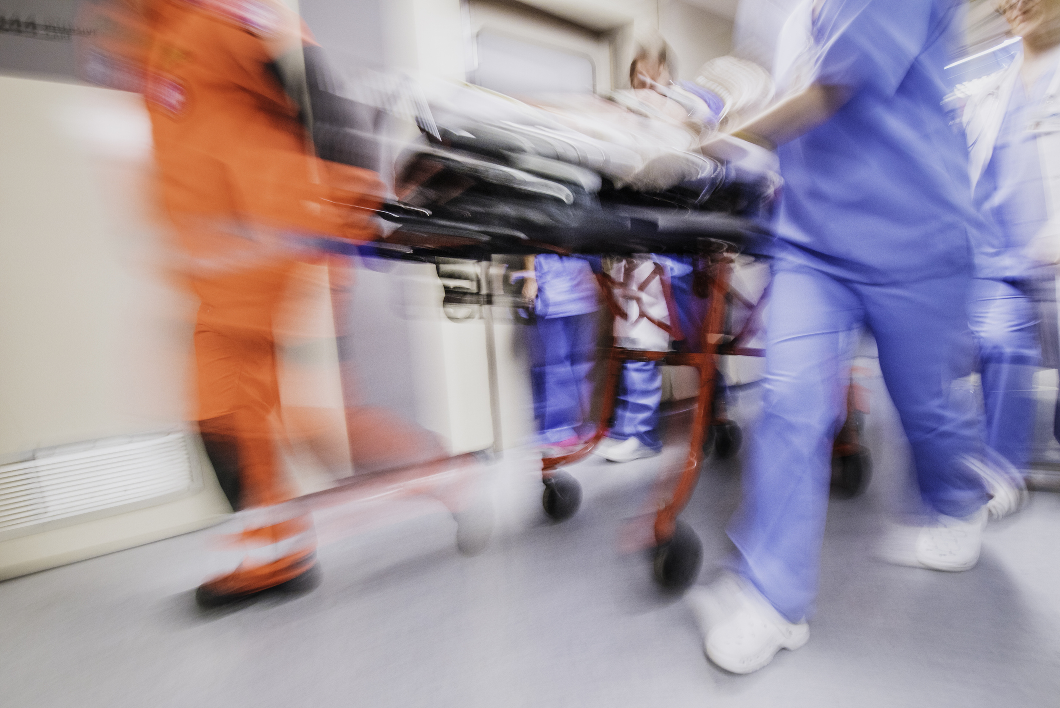
28th Annual Avera McKennan Trauma Symposium
October 26, 2022
Conference Agenda
7:00 a.m. Registration, Visit Exhibits, Continental Breakfast
^{7:30 a.m. Welcome} Michael Person, MD, FACS, Surgical Institute of South Dakota
7:40 a.m. VTE in the Trauma Patient
^{Michael Person, MD}
7:55 a.m. VTE Prevention: Medication Regimen
Zachary Muller & Kelcy Sorensen, PharmD, Avera McKennan Hospital
^{8:15 a.m. VTE: Orthopedic View} Tiffany Johnston, NP, Avera McKennan Hospital
^{8:35 a.m. Case Panel 1}
9:20 a.m. Break & Visit Exhibits
9:50 a.m. The Pressure is on to Get the Pressure Off
Dawn Bechtold, RN, Avera McKennan Hospital
10:10 a.m. VAP in the Trauma Patient
Michael Brozik, MD, Surgical Institute of South Dakota
^{10:25 a.m.} ^{VAP: Prevention & Actions}
Lanny Baker, RT, Avera McKennan Hospital
10:40 a.m. VAP: Pharmacy Actions
Kari Taggart, PharmD, Avera McKennan Hospital
^{10:55 a.m. Case Panel 2}
11:40 a.m. Lunch & Visit Exhibitors
1:10 p.m. When Disaster Strikes
Thomas Otten, Assistant Vice President Behavioral Health
^{2:20} ^{p.m. Break/Vendors}
2:40 p.m. Tornado/Avera Heart Hospital ED
^{Nancy Fisher, RN}
^{3:10 p.m. Case Panel 3}
^{3:55 p.m. Closing Remarks} ^{Michael Person, MD}

